Slide 1

HI What’s up???

Slide 2
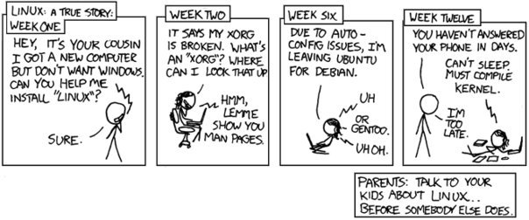
Tired of Linux?

Slide 3
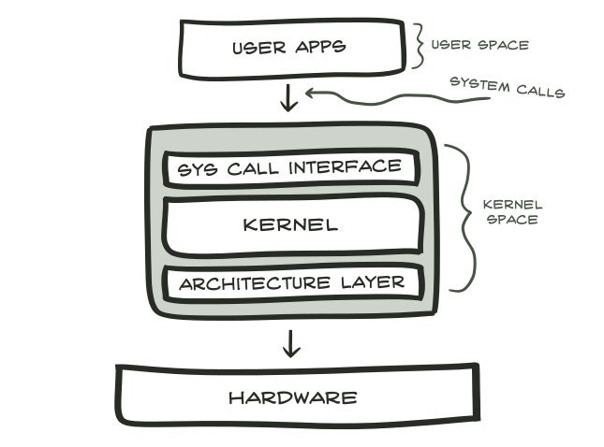
System Calls
A system call is as good as a function in C Programming Language.
Functions are limited to programming while system calls are specific for operating systems.

Slide 4
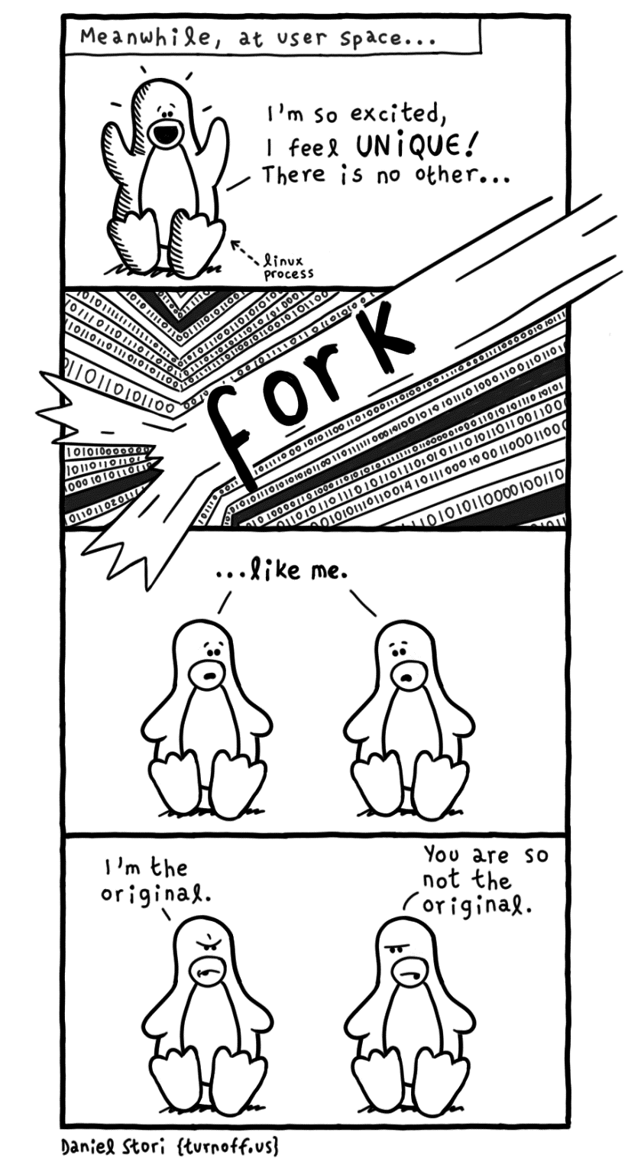
Fork()

Slide 5
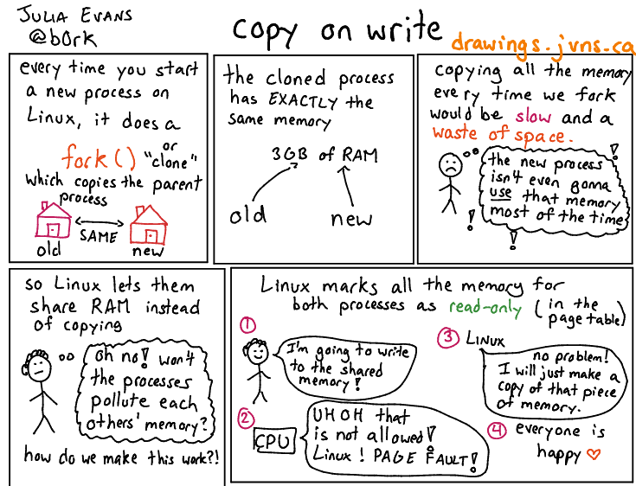
Copy On Write COW

Slide 6
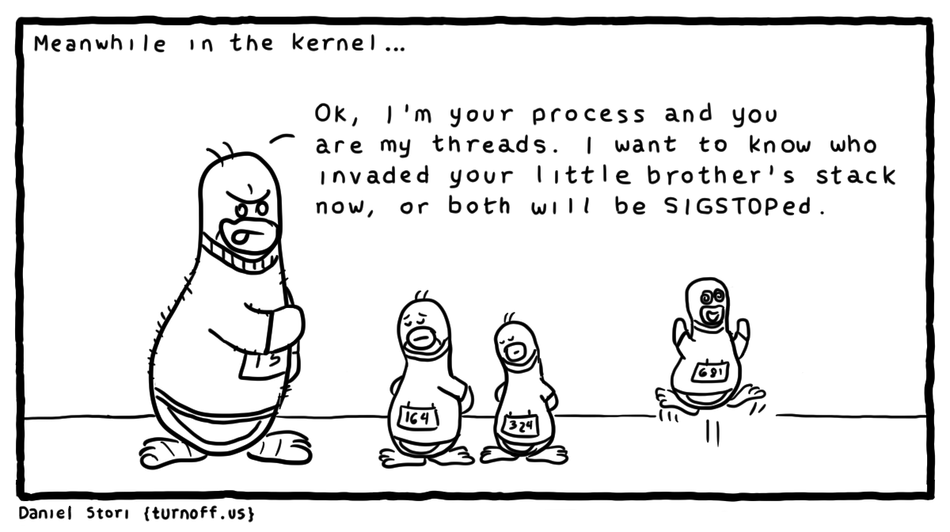
Threads within a Process

Slide 7
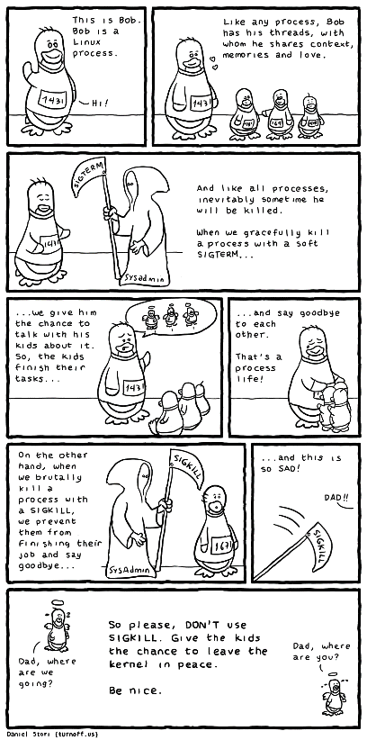
SIGTERM= When you shutdown
SIGKILL= Fatal

Slide 8
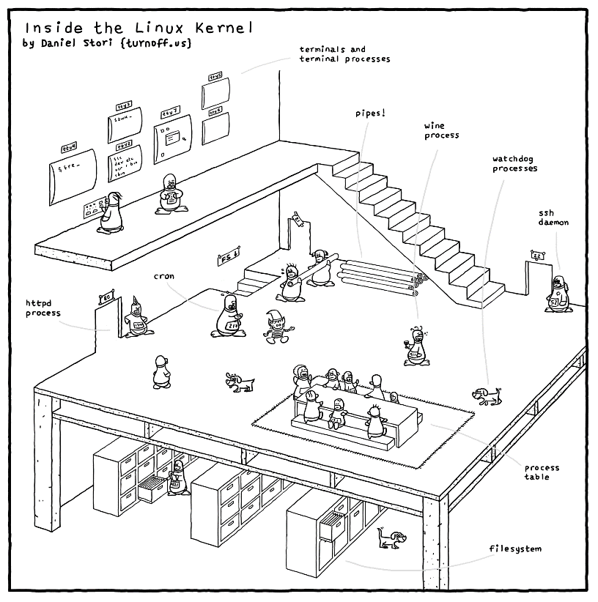

Slide 9
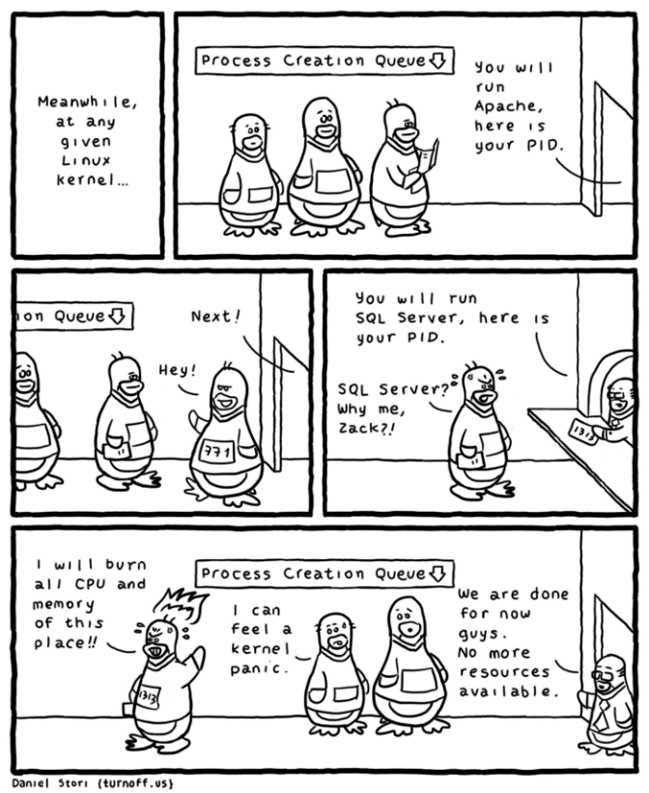

Slide 10
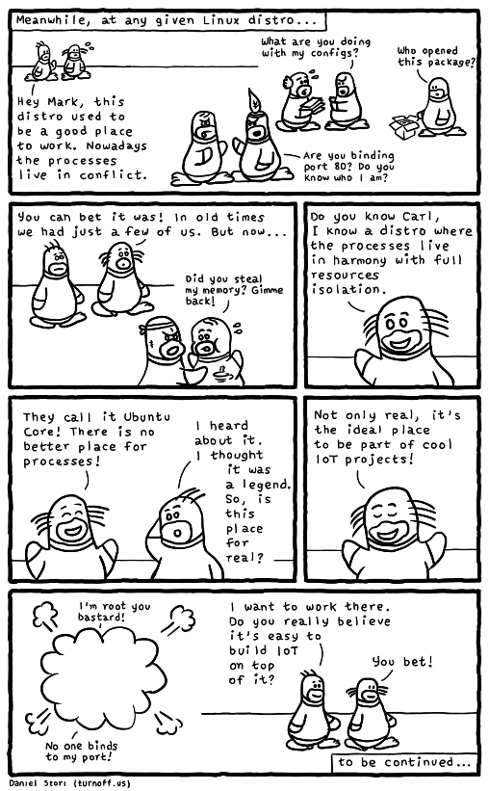
IoT

Slide 11
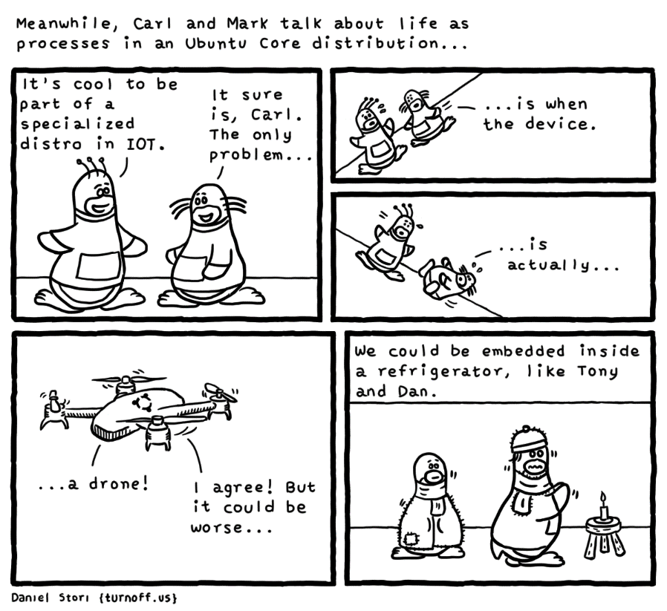

Slide 12
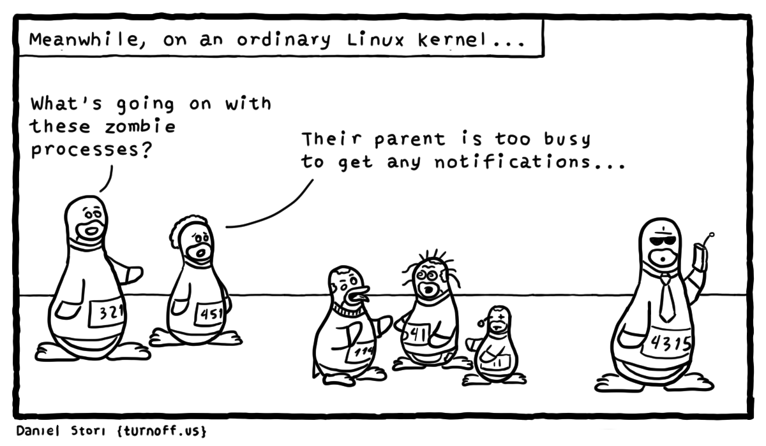
Zombie Process

Slide 13
Orphan Process
I couldn’t find the picture ☹

Slide 14
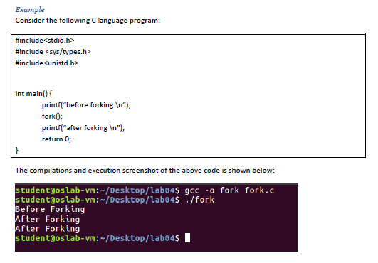
Example

Slide 15
Best of luck for Manual 4
Have A nice journey!

